Slide 1

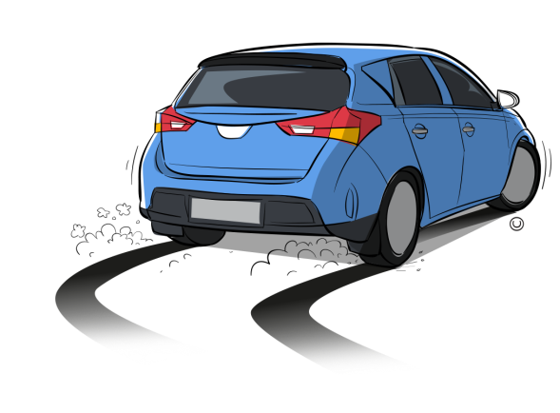
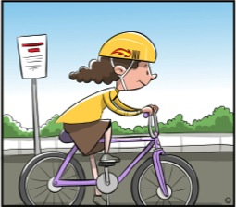
Types of laws
How they affect our lives

Slide 2

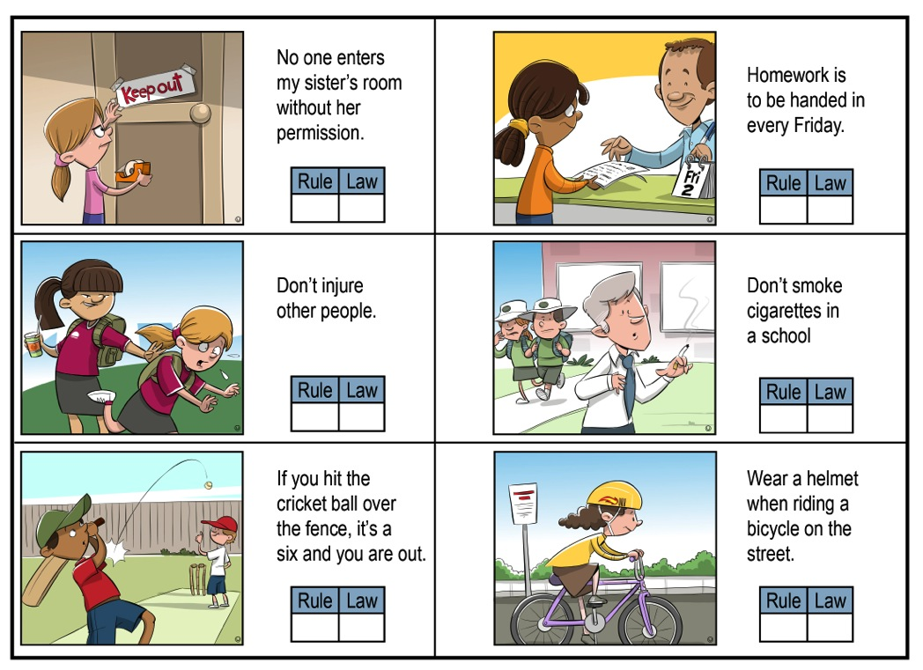
A rule or a law ?
There’s a difference between rules and laws.
Activity time
Why are rules and laws different?
Read each situation opposite and decide whether it is a rule or a law by placing a tick (✓) in the answer box.
Share your ideas and opinions with others.

Slide 3
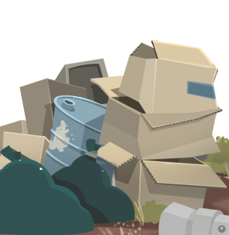

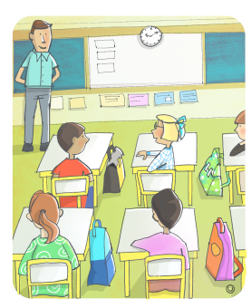


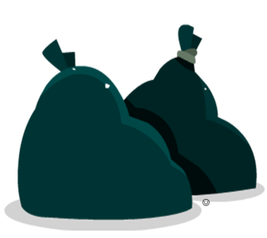
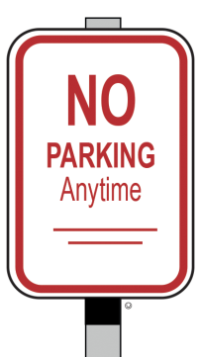



Examples of laws
waste disposal
barking dogs
attending school
keeping animals
traffic control
rubbish collection
parking
theft
Did you know that there are laws to address all these different issues?
water supply

Slide 4

Why do we make laws?
Governments make laws to protect the rights of citizens.
What are rights?
Rights are claims which are recognised as just and fair by society.
For example,
the right to feel safe;
the right to live in harmony; and
the right to live in freedom.
What are some rights of citizens?

Slide 5
Why do we make laws?
Laws are designed to protect society or solve problems that occur between individuals and groups.
How do laws protect society?
For example, laws about wearing a bike helmet have been developed because of the high number of head injuries suffered by cyclists.
For example, laws about cycling have been developed to resolve issues about road usage between cyclists and drivers.
How do laws solve problems?
Notes:
Laws are designed to protect society as a whole from wrongful action (police can take action). Civic laws help to solve problems which occur between individuals or groups (legal personnel and courts help solve problems).

Slide 6

Examples of laws that protect society or solve problems
Activity time
Select an issue, for example:
traffic control
attending school
barking dogs
keeping animals
rubbish collection
theft
water supply
parking.
Identify an example of a law that addresses the issue.
Decide if the law protects an individual’s rights or resolves a problem between individuals, and record.
Police can take action if someone breaks a law that protects society.
Legal personnel and courts help to solve problems involving laws that occur between individuals or groups.

Slide 7
Which law is responsible for which offence?
Select an issue
speeding carrying a weapon in public importing goods
theft radioactive waste disposal food hygiene
vandalism animal protection wearing a helmet
waste disposal public water supply trespassing
passports littering wearing seatbelts
Identify a type of law that would address it
Road laws | Health laws | Environmental protection laws
Public order laws | Property laws | Customs and border protection laws

Slide 8


Is there any other type of law in Australia?
Customary law in Aboriginal and Torres Strait Islander communities
Yes, customary law. It is an unwritten law which is thousands of years old.
Varies between different groups
The Dreaming and the Before Before Time is a time of creation when ancestral beings roamed the land and shaped the creation of human, plant and animal life and the physical features of the landscape.
Shared through stories, song, dance and art
Customary laws were created during the time of the Dreaming for Aboriginal peoples.
Explains behaviours, rights, roles and responsibilities
Customary law
Decides ownership over goods and territories, including animals, plants, water and land
Customary laws were created during the Before Before Time for Torres Strait Islander peoples.
Outlines punishments and consequences
Enforced by Elders
Some laws are sacred and cannot be shared

Slide 9
How laws impact Aboriginal and Torres Strait Islander peoples: Aboriginal hunting, fishing and gathering rights laws
Commonwealth Law: The National Parks and Wildlife Conservation Act 1975
How the Act applies to all Australians
ensures ‘the protection and conservation of wildlife, and the preservation of parks and reserves.’
How the Act applies to Aboriginal and Torres Strait Islander people
permits Aboriginal peoples to continue ‘in accordance with law, the traditional use of any area of land and water for hunting for food-gathering (otherwise than for purposes of sale) and for ceremonial or religious purposes.’
Quotes from Aboriginal Hunting, Fishing and Gathering Rights: Current Australian Legislation (Australian Law Reform Commission) http://www.alrc.gov.au/publications/report-31 CC BY-NC-ND 3.0 http://creativecommons.org/licenses/by-nc-nd/3.0/
Queensland Law: Changes to the Animal Care and Protection Act 2001 (the Act)
In 2012, the Queensland Government made changes to the Act to protect animals, including turtles and dugongs, ‘from unreasonable pain and suffering when hunted and killed.’ The changes to the Act:
remove the exemption from animal welfare obligations that used to apply to Aboriginal and Torres Strait Islander people
state how hunting rights can be exercised to ensure that animals are killed in a way that causes as little pain as possible
include that a person is guilty of cruelty if they have not used the best method that is reasonable, in their circumstance, to kill an animal in a way that causes as little pain as is reasonable.
Based on Animal care and protection during traditional hunting (State of Queensland: Department Agriculture, Fisheries and Forestry) https://www.daf.qld.gov.au/__data/assets/pdf_file/0020/75530/animal-care-and-protection-during-traditional-hunting.pdf CC BY 3.0 http://creativecommons.org/licenses/by/3.0/au/deed.en
Discussion time
1. How does customary law influence Australian law?
Discussion time
2. How is the dugong now protected under this law?
3. How are the lives of Aboriginal and Torres Strait Islander peoples affected by this law?

Slide 10
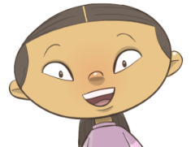
How laws affect our lives and the lives of citizens
It is the responsibility of citizens to abide by laws.
What are responsibilities?
Responsibilities are a range of obligations that people display.

Slide 11

Effect of law on citizens
Laws cannot discriminate against any person because of their race, gender or religious belief. But all Australians must follow Australian laws.
For example, customs and border-protection laws make sure that goods and people are transported legally across national, as well as international, borders.
If anyone illegally imports goods, they can be sentenced to 10 years in prison.

Slide 12

Effect of law on citizens
Identify the meaning of each consequence
What happens when we break the law?
imprisonment
supervised work, such as cleaning graffiti and collecting rubbish
fine
the promise of jail if another offence is committed in a given time period
suspended sentence
an order to pay money
community services
sending someone to jail

Slide 13
Type of laws
Road laws speeding parking seat belts not wearing a helmet driving without a licence | Health laws food hygiene waste disposal public water supply | Environment protection laws radioactive waste disposal wildlife conservation
Public order laws carrying a weapon in public | Property laws vandalism theft littering trespassing | Customs and border protection laws importing goods passports importing fauna and flora
Activity time
Select one of the above issues.
How might breaking this law affect a person’s life?
How might it change another person’s life?

Slide 14
Attributions
All images © DET

